Slide 1






Smart Traffic Management Using Deep Learning
Team ID : 6451
Babaria Institute of Technology
Team Leader – Rahul Shah

Slide 2

Problem Statement
Revolutionize traditional traffic management with an advanced system integrating deep learning object detection and real-time analysis. The project addresses the pressing need for efficient traffic management systems capable of mitigating congestion and ensuring smoother commuting experiences.

Slide 3
About the project
Our project introduces a pioneering method for traffic management, integrating cutting-edge technologies like deep learning and real-time analysis to revolutionize the way traffic flow is optimized and managed.

Slide 4
Why this project ?
We chose this project to address and overcome all the issues with traditional crowdfunding applications like :
Alleviate congestion by optimizing traffic flow and reducing travel times.
Enhance safety measures to minimize road accidents and ensure safer roadways.
Expedite emergency response by facilitating the passage of emergency vehicles during critical situations.
Embrace technological solutions to develop smarter traffic management systems for modern urban environments.
Improve commuting efficiency by optimizing travel routes and reducing congestion-related delays

Slide 5
Our proposed solution
To overcome all this issues in traditional crowdfunding applications, we are hereby providing our solution with key features like:
Real-time Object Detection! Implementing deep learning models for real-time vehicle detection within traffic streams.
Dynamic Traffic Flow Optimization! Utilizing data analysis to predict and adjust traffic patterns for enhanced efficiency.
Intelligent Token Passing Mechanism! Employing a token-based system to prioritize vehicle flow, especially for emergency vehicles.

Slide 6
Working
Initial
Function
Result
There are 4 lanes:
1st lane is open
2nd assigned X sec timer
3rd assigned STOP
4th assigned STOP
When 1st lane opens and it will trigger function which will analyse traffic of 2nd lane ,Using open CV and STOP lane
This function will return value X’ which will assign to 3rd lane timer & Repeat
Function- Assign time (sec) according to vehicle spotted .
Min-max value to avoid assigning insufficient time
Reduce unnecessary time
No other costs
Requirement—Full Time camera feed for Machine Learning real time traffic analysing

Slide 7
Why this project ?
We chose this project to address and overcome all the issues with traditional crowdfunding applications like :
Alleviate congestion by optimizing traffic flow and reducing travel times.
Enhance safety measures to minimize road accidents and ensure safer roadways.
Expedite emergency response by facilitating the passage of emergency vehicles during critical situations.
Embrace technological solutions to develop smarter traffic management systems for modern urban environments.

Slide 8
The Coding Part
Different languages we used in our project and why did we chose those technologies :
Python
YOLO
Solidity
Versatile
Real Time Object Detection
Computer vision tools
Readable
Timely detection of vehicles
image processing
Scalable
System efficiency
video analysis
Community-driven
Adaptive
traffic management algorithms

Slide 9


Enough with all the gibber-gabber and finally here is the first look of our application

Slide 10
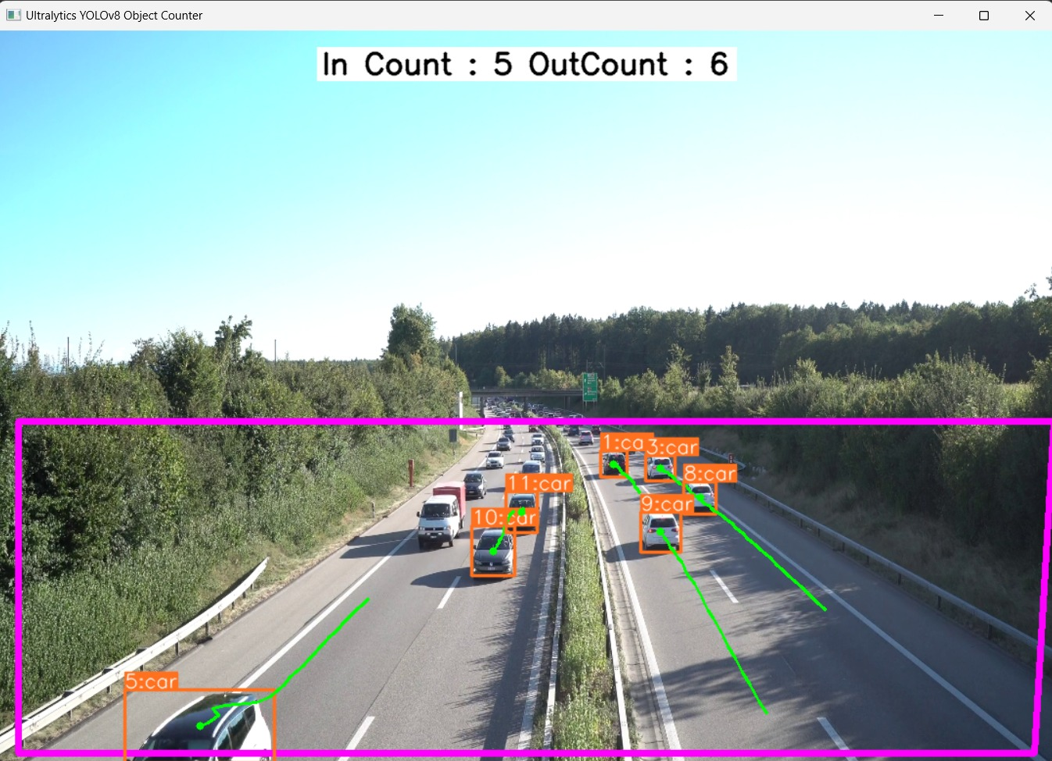

Slide 11
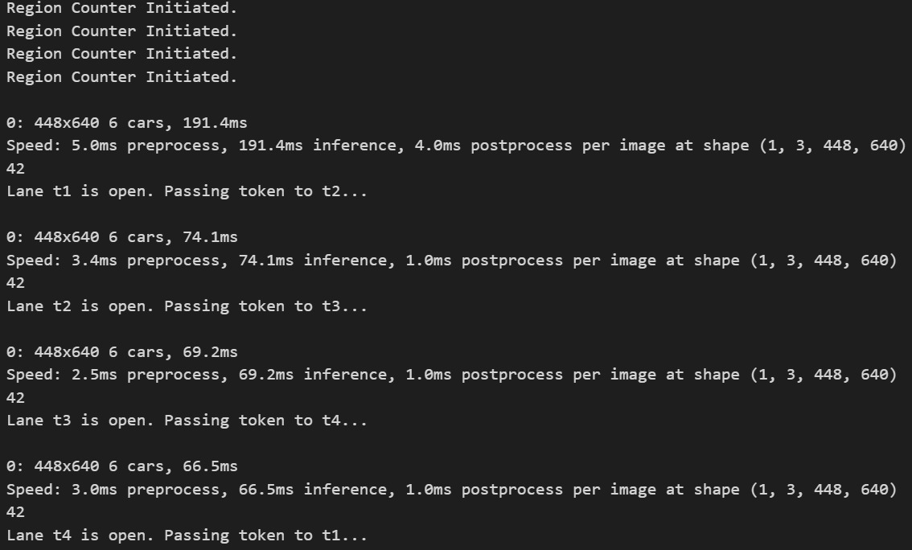

Slide 12
Summary
Concluding this presentation we would like to summaries it all because, why not ?!!
1
Key Points
Efficiency, Safety, Adaptability
2
Value Proposition
Enhanced traffic management.
3
Impact
Enhanced road safety.

Slide 13


Meet Our Team
Rahul Shah The technical lead on this project
Aadil Tansawala The technical sub-lead on this project
Vedanshu Sharma
Nishant
Prajapati
Smit Patel

Slide 14
Conclusion
In conclusion, developing this innovative traffic management system has been an exhilarating journey.
We trust that our efforts will significantly impact road efficiency and safety, and we're excited to witness the positive transformations.
Thank you for joining us on this remarkable journey, and we eagerly anticipate the continued evolution and success of our traffic management solution.

